Slide 1


Social Buzz
content

Slide 2


Today's agenda
Project recap
Problem
The Analytics team
Process
Insights
Summary

Slide 3

Social Buzz is a fast growing technology unicorn that need to adapt quickly to its global scale
Accenture has begun a 3 Month POC forcing on these task
An audit of Social Bizz’s Big Data Practice
Recommendation for successful IPO
Analysis to Find Top most 5 Popular Category of Content
Project Recap

Slide 4


Problem
Over 100000 Posts per day
36,500,000 pieces of content per year!
But how to capitalize on it when there is so much?
Analysis to find social Buzz’s top 5 most popular categories of content

Slide 5



Myself
Data Analyst
The Analytics team
Marcus Rampion
Senior Principal
Andrew Fleming
Chief Technical Architecture

Slide 6
Process
1
Data Understanding
2
Data Cleaning
3
Data Modelling
4
Data Analysis
5
Uncover insights

Slide 7

Insights
There is 17 unique Category are present
The most popular category got 74965 Reaction which is huge
May was the month in which posts are more

Slide 8
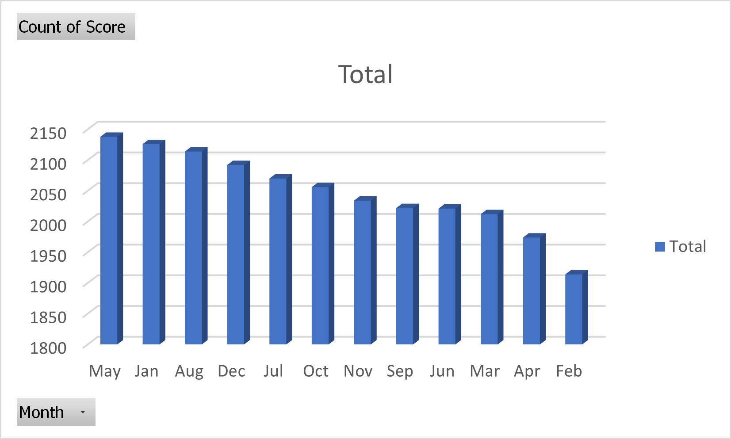

Slide 9
There are sixteen unique types of reaction that user used for posts
Most reacted reaction type is “Scared”
After “Scared ”, “Peeking ” and “Hate ” is counted Respectively
“Intrigued” is Least Used Reaction Type in the list.

Slide 10

After Cleaned we found total 24573 rows
As Analysis we found total 17 Unique category are used in data set.
“Animal ” is the top Category in the list followed by Cooking Culture Dogs etc
May is the month where user most interact with Buzz. Followed by Jan and Oct.
Summary

Slide 11

Thank you!
ANY QUESTIONS?

